Slide 1
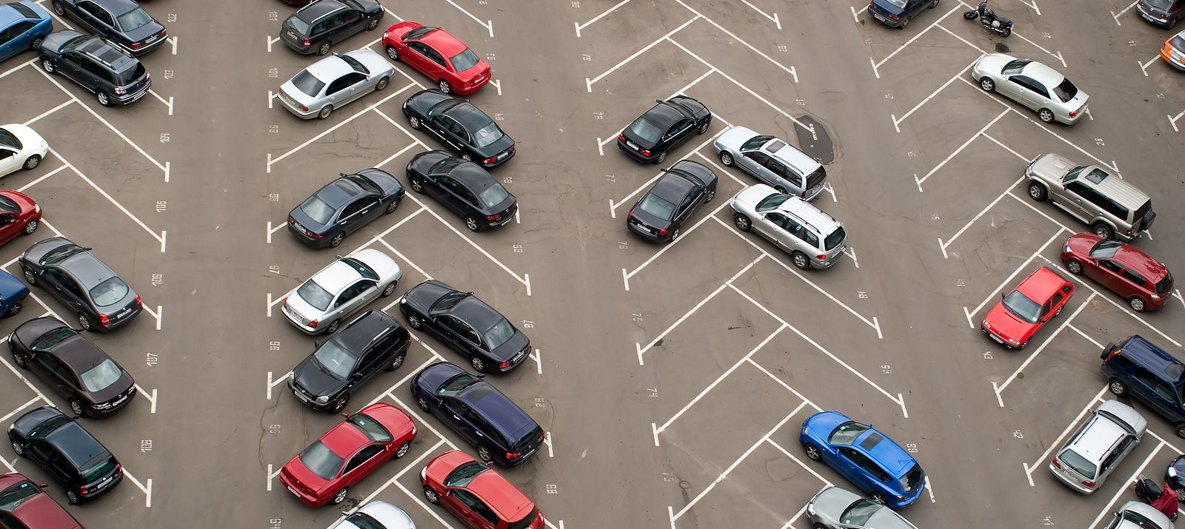
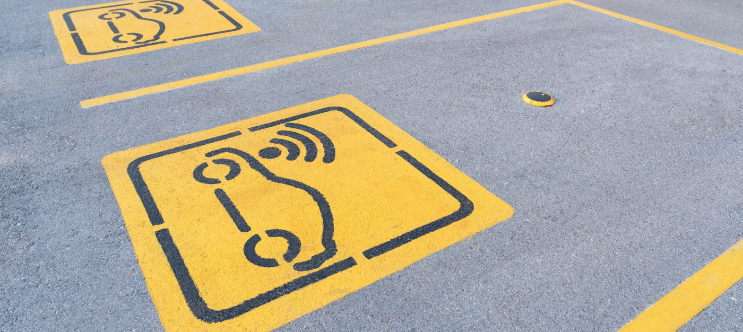

ParkUrWheels
Team Unplugged Techies

Slide 2

Team Members
Inzamul Hoque.
Shubham Kamble.
Snehal Gugale
Sujit Kharat.
Rajesh Pandhare.
Team Unplugged Techies

Slide 3
Overview
The main objective of parking system is to manage the details of duration , Vehicles ,Parking Slots , Customer and Parking Fees.
The objective of our hackathon topic is to automate and simplify parking slot concern.
With the use of high accuracy latest industry sensors to get run-time parking status.
Team Unplugged Techies

Slide 4

Why ParkMyWheels
Struggle-Free finding safe and nearby parking slot.
Get Real-time live data for available parking slots.
Pre-Book parking slot and Rent/List own parking slot.
Team Unplugged Techies

Slide 5
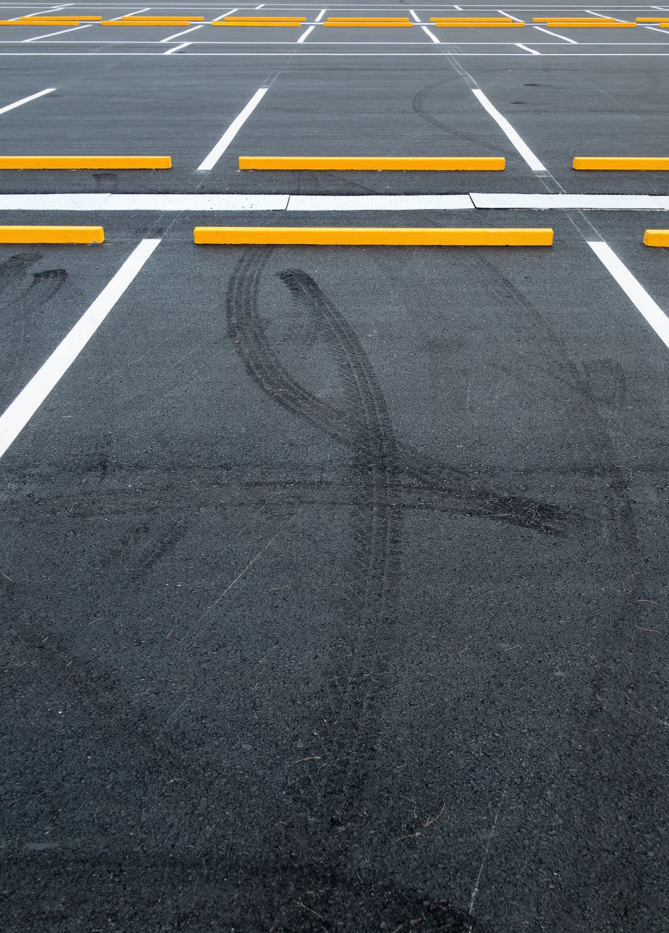
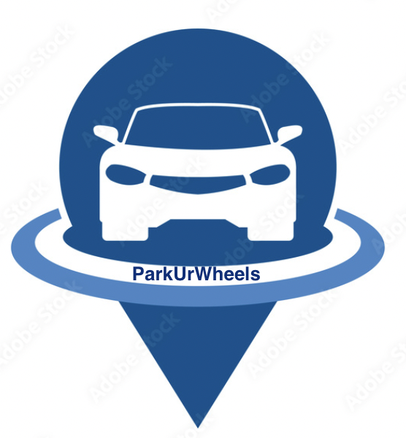
ParkUrWheels Features
Check nearby available parking slots.
Compare fare among nearby available parking slots.
Advance parking slot booking.
To get real-time status.
Map guidance to parking.
Team Unplugged Techies

Slide 6
System Design
Platform
Database
Front-End
Back-End
Application Flow
Team Unplugged Techies

Slide 7
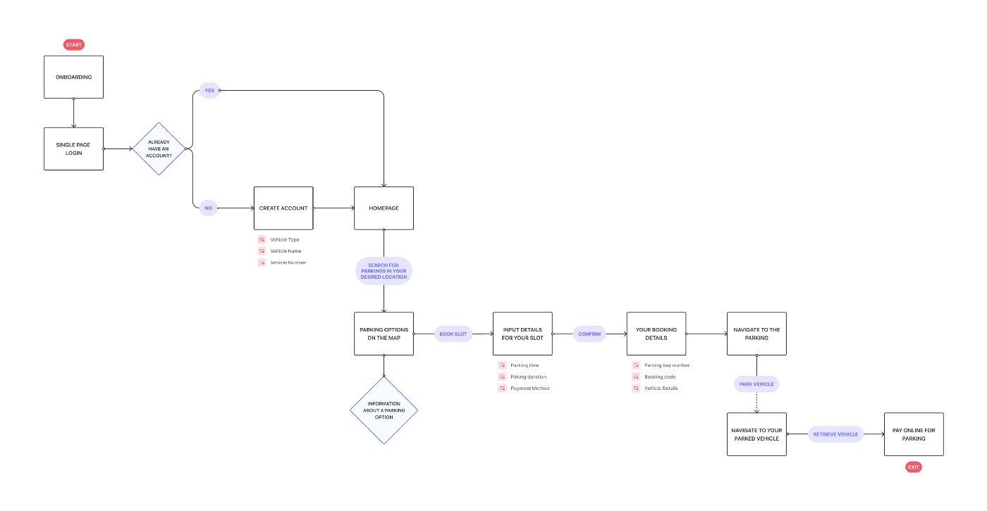
Application Flow
Team Unplugged Techies

Slide 8

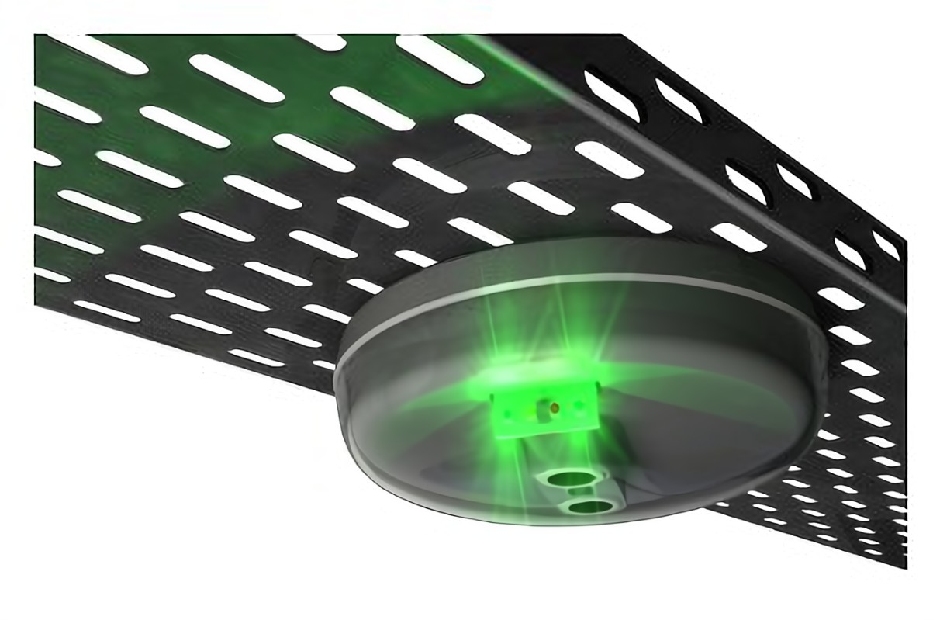
Parking Sensors
Team Unplugged Techies

Slide 9
Parking Sensors
1. Surface Mount :
This is more reliable and show real-time events with high accuracy.
2. Overhead Sensor
This is simple , very cost-effective and provide Colour coded LED overhead guidance Indicator and that allow user to see availability of entire rows of parking at a glance.
Team Unplugged Techies

Slide 10
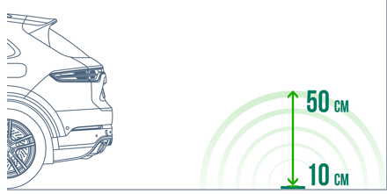
Sensor Mechanism
The current status of each spot is transmitted from the sensor to the Cloud, which in turn updates real time status of parking spot availability on the App. This will help Users of the number, type and location of available spaces at particular parking spot. Sensor will send data to cloud; backend will read that data and will update database so that real time status will get change on frontend.
Team Unplugged Techies

Slide 11
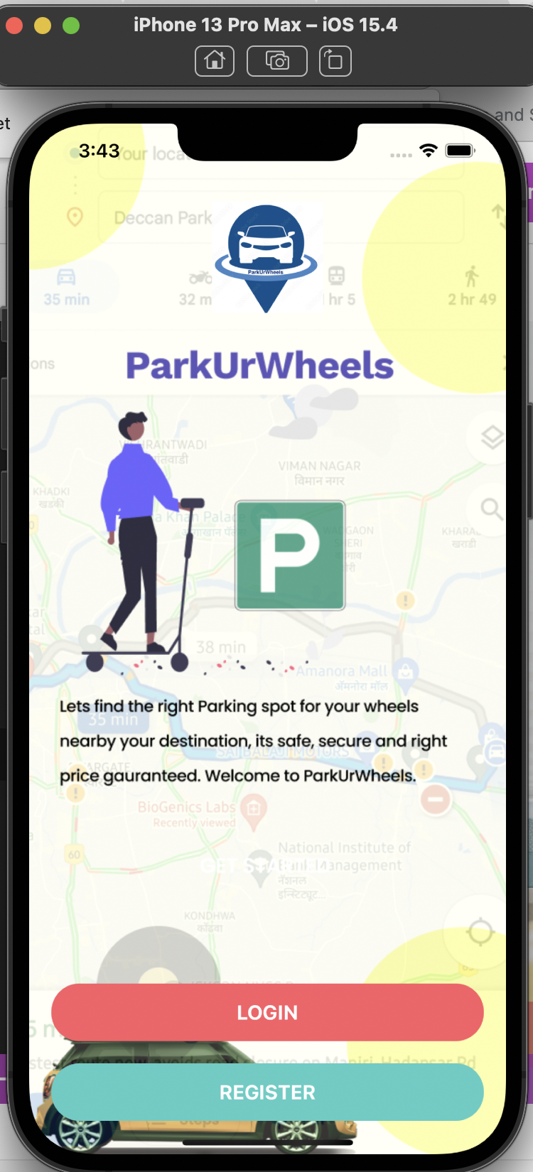
Login Screen

